Slide 1
What does your Gmail UserName consists of ?

Slide 2
STRINGS

Slide 3
To Be Covered
What is String
Memory Representation
Pooling
Why String is Immutable
String Functions
String Builder
String Builder Functions
String vs StringBuilder

Slide 4
What is String
▪ Strings, which are widely used in Java programming, are a sequence of characters.
Java programming language, strings are treated as objects.
Creating String objects:
String Literal:
String s = “chandu”;
Using new keyword:
String s = new String(“Java”);

Slide 5
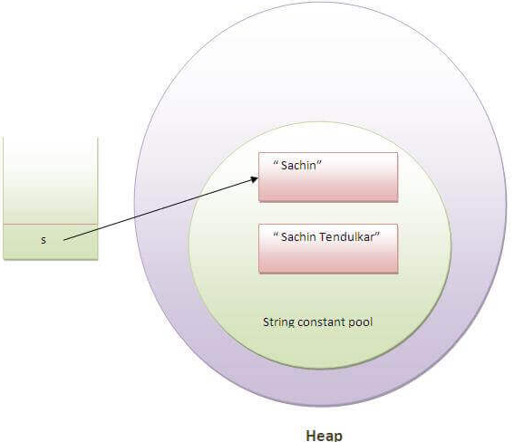
Memory Representation
String s = “sachin”;

Slide 6
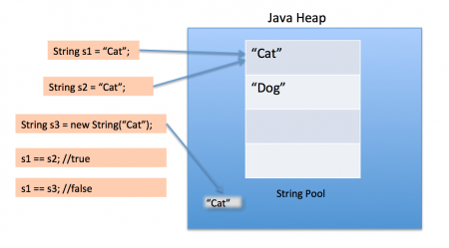
Pooling
String s1 = “cat”;
String s2 = “cat”;

Slide 7
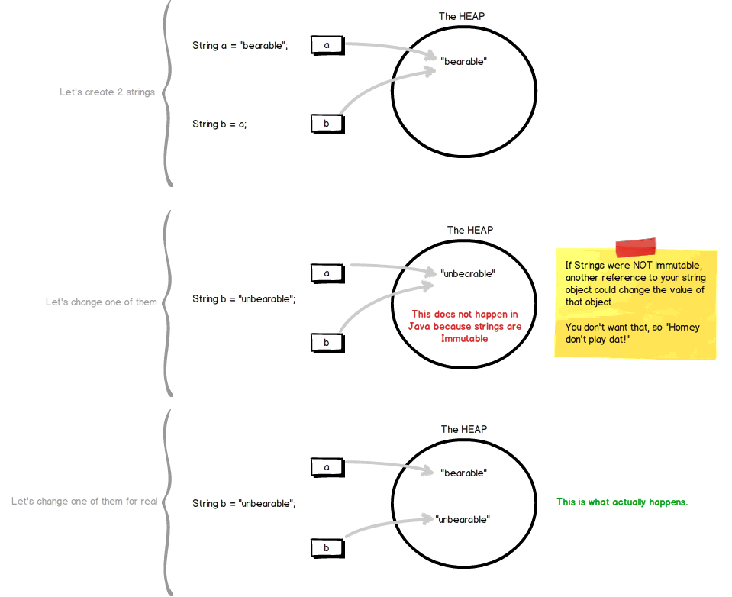
What Happens if String is mutable
If strings are mutable another
reference to your string object
could change the value of that
object

Slide 8
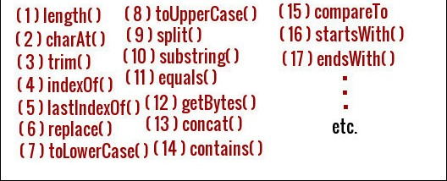
String Functions

Slide 9
String Builder
Java String Builder class is used to create mutable (modifiable) string.
it is non-synchronized.
It is available since JDK 1.5.
Creating of String Builder Object:
StringBuilder sb=new StringBuilder("Hello ");

Slide 10
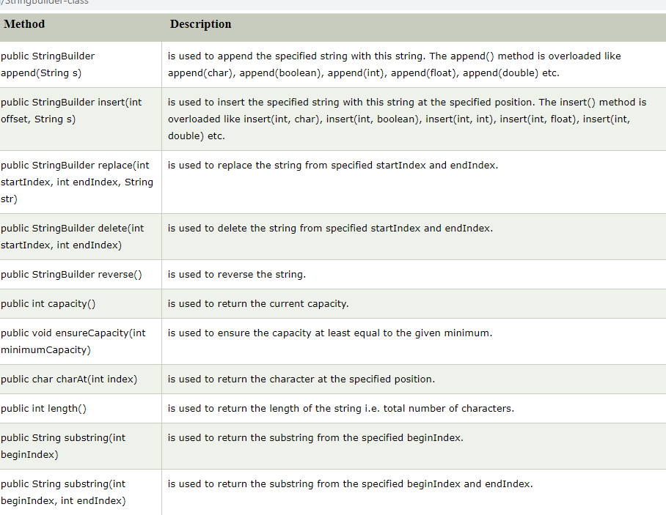
StringBuilder Functions

Slide 11
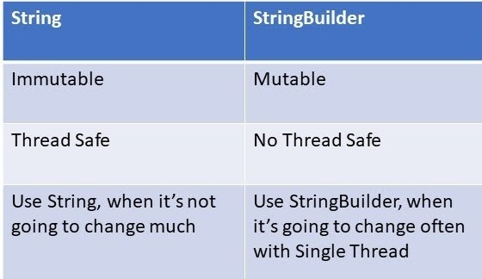
String vs StringBuilder

Slide 12
What we have learnt
What is String
Memory Representation
Pooling
Why String is Immutable
String Functions
String Builder
String Builder Functions
String vs StringBuilder

Slide 13
Thank You

